Slide 1
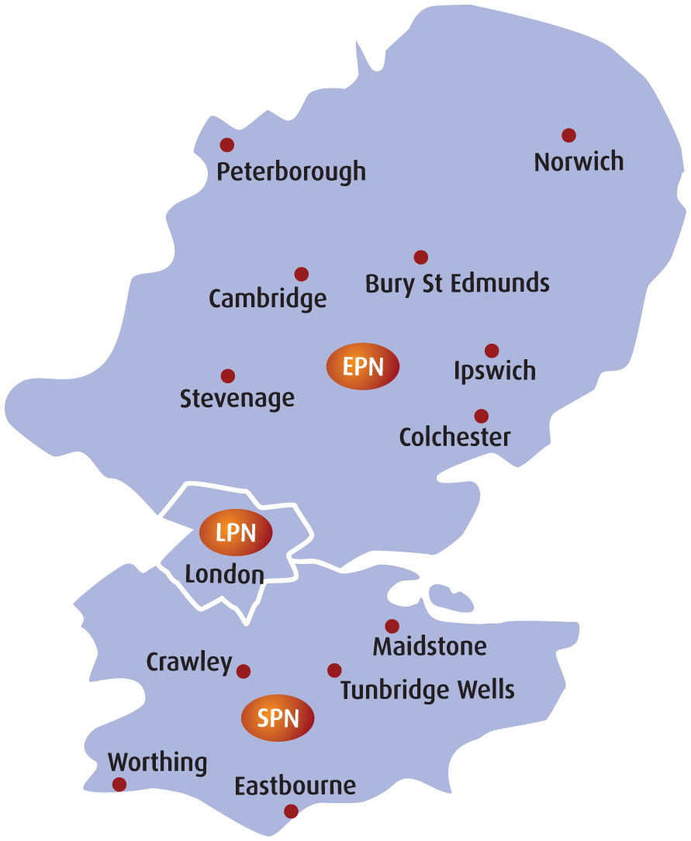
UK Power Networks Competition In Connections Management Team
A designer / delivery contact will be allocated at the appropriate stage of your project. If you need a point of escalation, the management team are listed below.
Contact | Job title | Contact details
Matthew Crittenden | Head of Competition in Connections | 07514 310637
Clare Maynard | Lead Design Engineer (EPN) | 07812 263313
Simon Barons | Lead Design Engineer (LPN) | 07875 115326
Rachel Williams | Lead Design Engineer (SPN) | 07875 110023
Danny Beer | Operations Manager Delivery (All Areas) | 07812 263518
Robyn Penniall | Operations Manager Self Connect (All Areas) | 07875 117727

