Slide 1
Partnering for the future of aviation

Slide 2
01
Egis Group
02
Aviation
03
Airports
04
ATM & Institutions

Slide 3
Egis Group
01.

Slide 4
About Egis
Egis is an international player active in the consulting, construction engineering and mobility service sectors.
We design and operate intelligent infrastructure and buildings capable of responding to the climate emergency and helping to achieve more balanced, sustainable and resilient territorial development.
With operations in 120 countries, Egis places the expertise of its 18,000 employees at the disposal of its clients and develops cutting-edge innovation accessible to all projects. Through its wide-ranging fields of activity, Egis is a central player in the collective organisation of society and the living environment of citizens all over the world.
01.
About Egis

Slide 5
Our shareholder structure
26%
40%
Partners Executive and Employees
Tikehau Capital
34%
Caisse des Dépôts

Slide 6
Our global offer
FIELDS OF ACTIVITY UNDERPINNED BY CROSS-GROUP AREA OF EXPERTISE
ENVIRONMENT – MOBILITY AND SYSTEMS – GEOTECHNICAL & COMPLEX STRUCTURES – DIGITAL
01.
About Egis

Slide 7
Along the entire value chain of projects
consulting
Engineering
Project structuring
Operation and maintenance
turnkey
Mobility services
01.
About Egis

Slide 8
Key figures
€1.48bn
28
ROAD OPERATING COMPANIES
ENR 21st
ENGINEERING NEWS RECORD GLOBAL RANKING
65% international
2022 TURNOVER
20
AIRPORTS
1st
FRENCH ENGINEERING COMPANY
79%
Consulting & engineering
21%
Operation & mobility services
43
URBAN PARKING LOTS IN FRANCE
8th
IN TRANSPORTATION MARKET
2022 Turnover
€48 M
DISTRIBUTABLE
NET PROFIT 2022
18,000
EMPLOYEES IN THE WORLD
Transportation
62
%
Energy & Sustainable Cities
38
%
€176M
EBITDA
74% Consulting & engineering
26% Operation & mobility services

Slide 9
Our values
A PEOPLE FIRST
A RESPONSIBLE
A CREATIVE
COMPANY
COMPANY
COMPANY
Developing the careers and skills of its employees
Incorporating the issues of sustainability and ethics within projects and towards our stakeholders
Taking a proactive stance on innovation to meet tomorrow’s challenges
01.
About Egis

Slide 10
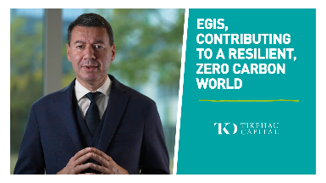
Climate emergency, our absolute priority
OUR 5 COMMITMENTS to take concrete action for the environment on a daily basis
OUR COMMITMENTS IN VIDEO
Reduce our greenhouse gas emissions
Reduce emissions from our clients' projects
Strengthen carbon sequestration
Evolving our business portfolio in line with the Paris Agreement
Strengthen the resilience of territories and infrastructures
01.
About Egis

Slide 11
A local international player
Asia-pacific
Hong-Kong, China
13 countries
27 locations
2,150 employees
EUROPE
Paris, France
17 countries
79 locations
9,090 employees
Americas
São Paulo, Brazil
6 countries
10 locations
1,800 employees
India
New Delhi
3 locations
2,040 employees
Africa
Casablanca, Morocco
14 countries
14 locations
580 employees
Middle-east
Dubai, United Arab emirates
8 countries
15 locations
2,340 employees
01.
Markets & Services

Slide 12
Impact the future
Over its 70-year history. Egis has brought together the expertise of companies specializing in various sectors of activity, in France and abroad.
2022
WME
(consulting, Middle East)
AG Concept
(buildings, France)
Payc
(buildings, Colombia)
SB Architects
(buildings, USA)
Waagner Biro Bridge Services International
(operation, Middle East)
Weston Williamson + Partners
(buildings, United Kingdom)
Nebu Transports Services
(urban mobility, Netherlands) Nord Signal
(rail, France)
Before 1998
Foundation of the group’s historical companies:
Bceom (1949),
Beture Infrastructure
(1960), OTH International, Séchaud et Metz, Semaly (1968), Scetauroutei (1970), Isis (1990), Sofreavia (1969)
2013
Helios (aviation consulting, United Kingdom)
2018
Plantier
(buildings, France)
Michel Frustié
(construction economists, France)
EXYZT
(urban mobility, France)
2011
losis Group
joins Egis (France) Vega (rail, Brazil)
Transpass (urban mobility, Netherlands)
2016
Versluis
(road, Netherlands)
2020
Voltere
(tourism, France)
Est Signalisation
(rail, France)
1998
The General Assembly adopted the name « Egis »
2021
CPMS (rail, United Kingdom)
Galson Sciences Ltd (nuclear, United Kingdom)
lndec (technical assistance, Australia)
KERN (buildings, France)
Openergy (energy performance, France)
Sisprobe (geotechnics, France)
AD lngé (asbestos removal, France)
Ubiplace (digital, France)
MT3 (mobility, France)
BUDI Technology lnc (mobility, Philippines)
SunlandPlus (buildings, Hong Kong) Lautrec (buildings, New Zealand)
2012
Aeroservice
(airport consulting and engineering, Brazil)
2015
Projacs
(project & construction management
Middle East)
Lenc
(engineering, Brazil)
2019
lnhabit
(Facade engineering,
Hong Kong)
2017
10 DESIGN
(architecture and design, Hong Kong)
OCACSA
(road operator, Mexico)
Creation of Cycle Up with lcade and Moovia with Urbis Park Services
01.
About Egis

Slide 13
Our flagship innovations follow 4 main themes
ECOLOGICAL AND ENERGY
TRANSITIONS
Mobility & transportation
of the future
Sustainable city
construction
Engineering
4.0
All our innovations in the 2020 book "50 innovations by Egis"
01.
About Egis

Slide 14
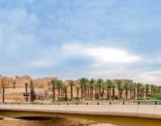
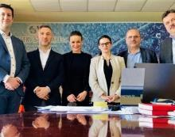
Emblematic projects won
– Saudi Arabia –
DIRIYAH SOUTH & GARDENS DISTRICTS
– Romania –
WATER SUPPLY & SANITATION IN SATU MARE COUNTY
– Baltic States –
RAIL BALTICA FUTURE HIGH-SPEED RAIL
– Chile –
SANTIAGO METRO
– Philippines –
UNDERGROUND METRO IN MANILA
Project Management Consultancy services to a part of DGDA’s retail and heritage masterplan (Diriyah Gate Development Authority)
Development of the water and wastewater infrastructure, for safeguarding access to clean drinking water for as many localities as possible
Systems project management assistance for the new line 7 of the Santiago metro -
100% automatic, 26 km, 19 stations
Major contract to design and equip the country’s first underground metro line - 35 kilometres, 15 stations
Rail Baltica European High Speed Line Project -
engineering contract to prepare, procure and supervise Rail Baltica Control-Command and Signalling subsystem deployment
01.
About Egis

Slide 15
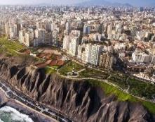
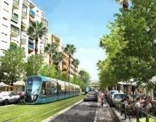
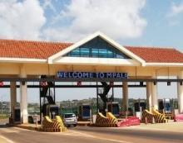
Emblematic projects won
– United Kingdom –
GREATER MANCHESTER CLEAN AIR ZONE
– Peru –
STRATEGIC ROAD PROJECTS
– UGANDA –
TOLL ROAD OPERATION & MAINTENANCE
– France –
On-street parking in Montpellier
– France –
NEW TRAMWAY LINE IN NICE
5-and-a-half-year contract to deliver the UK’s largest Clean Air Zone, to secure healthy and sustainable growth
Technical Assistance and PMO services for 10 years supporting the construction of 2 strategic road projects for the economic development of the country
5-year contract with the city of Montpellier (Transports Agglomération de Montpellier (TaM)) for the supply of an overall solution to automatically enforce on-street parking
Project management for the 4th tramway line in the Nice metropolitan area which will link Nice, Saint-Laurent-du-Var and Cagnes-sur-Mer
Operation and maintenance of the first toll road in Uganda.
The Kampala-Entebbe Expressway (2x2 lanes) with a total length of 26.2 km includes 3 toll plazas at each entrance and 17 toll lanes
01.
About Egis

Slide 16
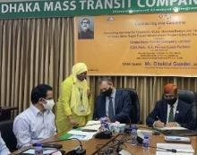
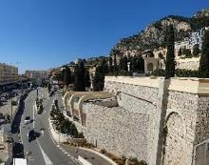
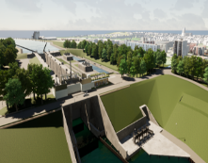
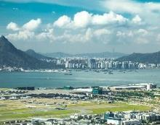
Emblematic projects won
– Bangladesh –
DHAKA METRO LINE 5 SOUTH
– Monaco –
NEW THERMO–FRIGORIFIC PRODUCTION PLANT
– Brazil –
SAO PAULO STATE RAILWAY NETWORK
– France –
CANAL-SEINE NORD EUROPE
– HONG KONG –
HONG KONG AIRPORT THREE-RUNWAY SYSTEM
A new design contract for the first underground metro line in the country:
15 km long
12.8 km is underground
4.6 km of viaducts,
includes 15 stations
Project management for the construction of the heating and cooling production plant within the industrial base (project for the development of the SNCF wasteland on the Charles III block)
Comprehensive programme management contract for the two main sectors: 107 km of waterway
6 locks
4 canal bridges
61 road and rail bridges
4 multimodal platforms...
Consultancy on procurement, design, safety assessment, cutover and transition of new and upgraded/replaced ANS equipment; as well as on-site technical assistance during installation, integrationand transition -20 engineers and experts involved
Environmental management, delivering
25 neighborhood impact studies on the São Paulo state railway network under concession from the client, with an extension of
1,989 kilometers
01.
About Egis

Slide 17
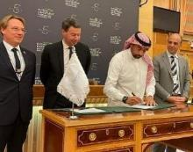
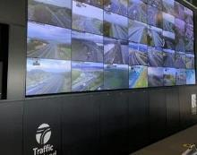
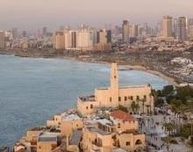
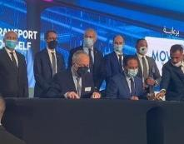
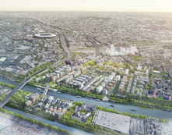
Emblematic projects won
– Saudi Arabia –
AL ULA PROJECT
– United Kingdom (Scotland) –
ROAD MANAGEMENT
– France –
DEVELOPMENT OF THE ATHLETES’ VILLAGE WITH SOLIDEO
– Israel –
TEL AVIV METRO
– Egypt–
CAIRO METRO
Strategic partnership between the RCU and the French consortium led by Egis for accelerating the development of Al Ula (Medina Region)
5-year contract to operate, with IBI Group, the Traffic Scotland National Control Centre and manage the Scottish Trunk road network (3,500 km of roads including the key inter-city motorways
Network Management of Tel Aviv Metro, the largest infrastructure project ever undertaken in Israel with 3 lines, 150 km, and 109 stations
MOU with the National Authority for Tunnels (NAT) for Greater Cairo metro line 6 studies
Project management of all the public spaces hosting the Athletes’ Village in the municipalities of Saint-Denis and Saint Ouen-sur-Seine
01.
About Egis

Slide 18
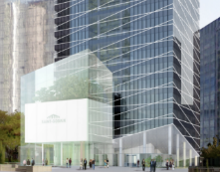
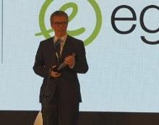
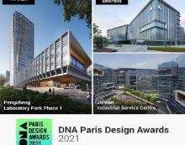
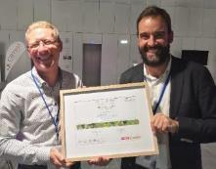
Prestigious awards received
– France –
EMPLOYEE PREFERRED
– France –
CTBUH AWARDS 2021
– France –
INFRASRUCTURES AWARD FROM IDRRIM
– International –
DESIGNER OF THE YEAR AWARD
– International –
DNA PARIS DESIGN AWARDS
Egis placed 2nd among the companies preferred by engineering and control employees in Capital Magazine’s 2021 ranking.
Two Awards of Excellence for 10 Design for the Saint-Gobain Tower in Courbevoie. Award of Excellence for the best building between 300 and 399 meters high for Zhuhai Tower in China
For Egis at the "Infrastructure and Construction Diamonds" gala in Poland
Two 10 Design projects awarded: "Pengcheng Laboratory Park Phase 1" in Shenzhen and "International Service Center" in Jinwan
"Infrastructures for Mobility, Biodiversity & Landscape" award from IDRRIM for nesting boxes integrated into the acoustic barriers of the A480 motorway
01.
About Egis

Slide 19
Aviation
02.

Slide 20
2022 key figures for Aviation
€70.4million
2022 Turnover
2022 TURNOVER
France
33
%
25%
Airport Operations & Management
Europe & Africa
38
€68.2M
2019
%
Middle East & South Asia
21
%
34%
Airport Consultancy
& Engineering
42%
ATM
€103.5M
2026 ambition
8
Americas & Pacific
%
+50
YEARS
of experience
20
AIRPORTS
1,700
AVIATION STAFF IN THE WORLD
+260
where Egis is shareholder or partner in operations
PROJECTS in 2022

Slide 21
Delivering end-to-end services in aviation for over 50 years
Consultancy
Engineering
Operations
INTEGRATION & OPERATIONAL SUPPORT​
LONG-TERM DECISION-MAKING & STRATEGY​
MANAGEMENT, OPERATIONS & DEVELOPMENT​
PROJECT PLANNING & DEVELOPMENT​
PROJECT & CONSTRUCTION​
MANAGEMENT​
DESIGN & ENGINEERING​
02.
Aviation

Slide 22
Egis are leaders in optimising the future of aviation
BRINGING PROJECTS TO LIFE AT EVERY STAGE
DEMONSTRATED EXPERTISE
From business strategy, to performance, through to planning, designing, operating and maintaining sustainable infrastructure.
50 years’ experience delivering airport and ATM projects across the globe.
MORE THAN AIRPORT EXPERTS
UNIQUE UNDERSTANDING OF THE AIRPORT ENVIRONMENT
As leaders in Air Traffic Management, clients trust that the solutions we provide consider the entire airport operational environment, from ground to air.
Award-winning consultants and engineers, also operating airports for more than 30 years.
02.
Aviation

Slide 23
Our strategic priorities
SUSTAINABILITY
FUTURE AIR
MOBILITY
DIGITALISATION & CYBERSECURITY
Developing the careers and skills of its employees
Incorporating the issues of sustainability and ethics within projects and towards our stakeholders
Taking a proactive stance on innovation to meet tomorrow’s challenges
02.
Aviation

Slide 24
Providing consultancy, design and engineering to all aviation stakeholders
Airport Operators & Developers
Air Traffic Management Stakeholders
Institutions & Governments
Design & Construction Firms
Aircraft & System Manufacturers
02.
Aviation

Slide 25
Today’s aviation challenges
CLIMATE CHANGE
Implications for my business?
How to reduce environmental footprint?
How to build resilience to climate impacts?
What strategy for the future?
Infrastructure requirements?
How to prepare for drones and UAM?
Immediate priorities?
How to deliver better returns?
New business models / partnerships?
02.
Aviation

Slide 26
Airports
03.

Slide 27
Supporting airports, from concept to operation
Consultancy
Engineering
Operations
MANAGEMENT OF OPERATIONS
LONG-TERM DECISION-MAKING, & STRATEGY​
TECHNICAL ASSISTANCE
OPERATIONAL CONSULTANCY
PROJECT & CONSTRUCTION MANAGEMENT
AIRPORT / AIRSPACE
DESIGN & ENGINEERING ​
03.
Airports

Slide 28
Deep sector knowledge & operational experience
our AIRPORT
NETWORK
20 AIRPORTS
4 CONTINENTS
8 COUNTRIES
KEY FIGURES 2021
11.6 million PASSENGERS
160,000 tonnes OF FREIGHT
1,400 EMPLOYEES
BELGIUM
ANTWERP
OSTEND
France
PaU
Bergerac
Brest
quimper
Cyprus
Larnaka
PaFos
Brazil*
Jacarepaguá
Campo de Marte
Ivory coast
Abidjan
Tanzania*
Zanzibar
AAKIA
Pemba
Congo
Brazzaville
Pointe Noire
Ollombo
French Polynesia
TAHITI FAA’A
Bora Bora
RAIATEA
RANGIROA
* Technical Service Agreement
03.
Airports

Slide 29
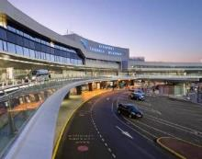
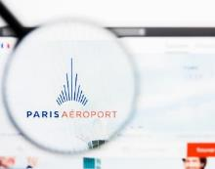
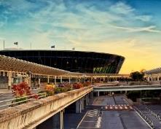
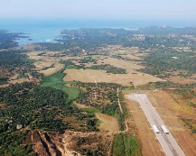
Flagship airport projects in France
TOULOUSE-BLAGNAC AIRPORT
CLERMONT-FERRAND AUVERGNE AIRPORT
COLLECTIVITE DE CORSE
AEROPORTS DE PARIS
NICE-COTE D’AZUR AIRPORT
Master plan, capacity analysis, and recommendations on development and long-term strategy.
Engineering, procurement and construction management of main runway and taxiways refurbishment
Read more
Airport development strategy to 2030
Framework agreement to support Groupe ADP in the management of its airport IT systems projects
Project management (design phase) of new baggage handling system in terminals 2, 3
Master Plan for the development of 4 airports on the island of Corsica: Ajaccio, Bastia, Calvi, Figari
03.
Airports

Slide 30
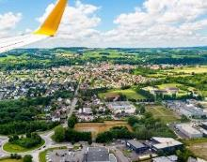
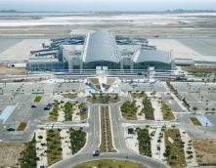
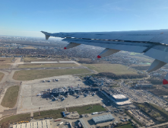
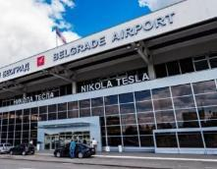
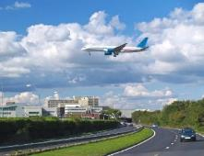
Flagship airport projects in France
– Switzerland –
EUROAIRPORT TERMINAL
– Cyprus –
LARNAKA / PAFOS AIRPORTS
– UK –
GATWICK AIRPORT
– Ireland –
DUBLIN AIRPORT
– Serbia –
BELGRADE AIRPORT
Airport terminal master plan, traffic forecasts and infrastructure development scenarios to plan for and anticipate future expansion
ORAT, change management and operational support
Advisor for over 10 years on capacity assessment and analysis related to proposed capital expenditure projects
Capacity assessment of airspace, airport airside, city-side and terminal
Advisor since 2016,
reducing the impact of aviation noise on local communities
Read more
03.
Airports

Slide 31
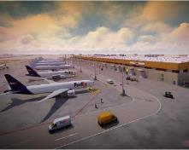
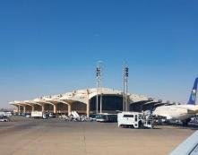
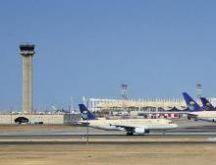
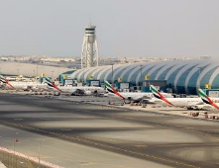
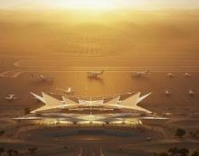
Flagship airport projects in the Middle East
– Bahrain –
BAHRAIN AIRPORT CO.
– Saudi Arabia –
KING KHALID INTERNATIONAL AIRPORT (KKIA)
– Saudi Arabia –
AMAALA AIRPORT
– Saudi Arabia –
SAUDIA AIRLINES
– UAE –
DUBAI AIRPORTS
Project management consultancy of a major cargo hub in the Middle East. Providing a flexible cargo infrastructure with phased options to accommodate future growth.
Read more
Riyadh Project management consultancy (PMC) services for airside projects
Provision of ORAT consultancy for Saudia ahead of its move to a new hub terminal at Jeddah Airport
ORAT support, technical and operational support during the closure of north runway, airport capacity studies and business continuity studies
Concept masterplan, aeronautical study, concept and schematic design of a greenfield airport infrastructure, project and construction management, and ORAT services
03.
Airports

Slide 32
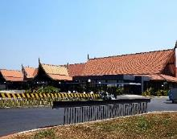
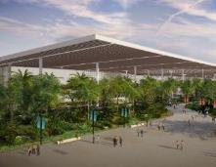
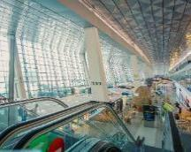
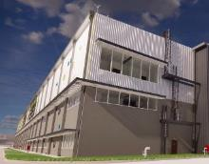
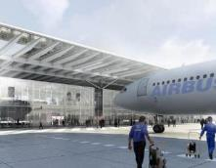
Flagship airport projects in APAC/India
– Cambodia –
SIEM REAP, SIHANOUKVILLE & PHNOM PENH AIRPORTS
– India –
AIRPORT AUTHORITY OF INDIA
– China –
AIRBUS SAS
– Indonesia –
WORLD BANK GROUP
– India –
DRAL
Technical assistance for runway overlay
Project management consultancy for construction of new integrated passenger terminal including city-side development works
Airport PPP Technical Advisory of a large hub in South East Asia
Architectural/engineering design and site supervision for final assembly lines for Falcon jets in Nagpur
Development of technical functional program, concept design and site supervision for completion and delivery center
03.
Airports

Slide 33
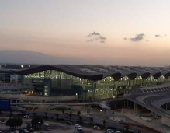
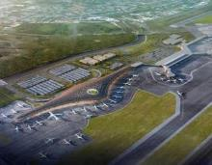
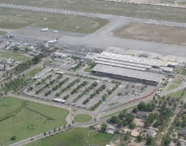
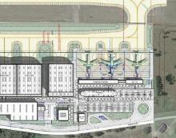
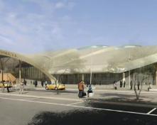
Flagship airport projects elsewhere in the world
– Algeria –
ALGIERS AIRPORT NEW TERMINAL
– Panama –
TOCUMEN AIRPORT
– Chad –
DJERMAYA INTERNATIONAL AIRPORT
– Cote D’ivoire –
ABIDJAN INTERNATIONAL AIRPORT
– USA –
AIRBUS SAS
Main ORAT consultant
ORAT consultancy and project management for the new passenger terminal building at Tocumen International Airport
Soil.is
Environmental analysis and action plan relating to carbon soil sequestration techniques
Read more
Development of technical functional program and architectural/engineering concept design for the final assembly line in Mobile, Texas
Design studies of the new Djermaya International Airport
03.
Airports

Slide 34
ATM & Institutions
04.

Slide 35
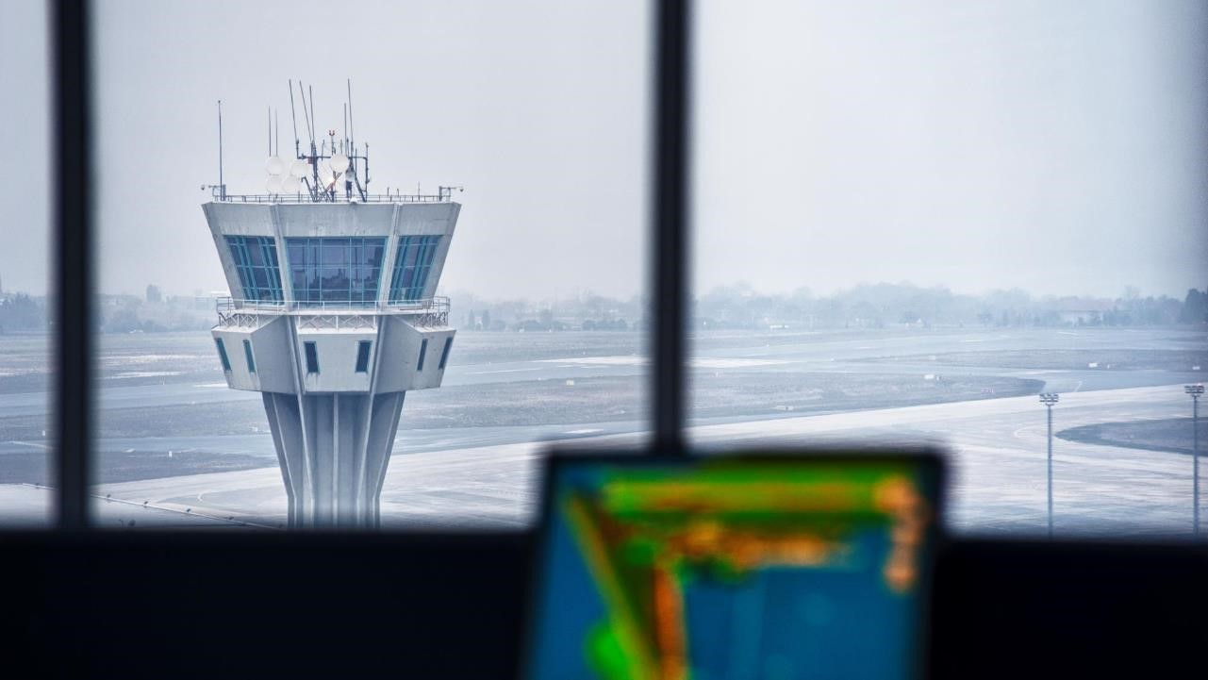
Value added across the whole ATM cycle
PROGRAMME MANAGEMENT, OPERATIONS & DEVELOPMENT
Consultancy
Engineering
Operations
LONG-TERM DECISION MAKING, STRATEGY AND R&D
Experienced support in managing and monitoring the operational performance of the ATM system with a focus on maintaining safe and efficient operations.
Independent advice on future ATM transformation and the latest technology and concepts, from business planning, masterplans and CBAs to CONOPS definition and regulatory approach.
SYSTEM IMPLEMENTATION & TRANSITION TO OPERATIONS
OPERATIONAL & TECHNICAL SYSTEM DEFINITION & DESIGN
Experienced management support and informed technical assistance for integration, validation and deployment of ATM system change.
Trusted technical expertise in deriving operational, functional, safety and performance requirements for ATM system development and procurement.
04.
ATM & Institutions

Slide 36
supporting decision-making
IN-DEPTH MARKET UNDERSTANDING
Independent, trusted counsel and nuanced analysis to advise on aviation matters, including investments and due diligence
TRUSTED TECHNICAL EXPERTISE
Delivering training and ‘capacity building’ on safety standards, regulations and best practice, from state safety programmes to airworthiness and legislation
EXTENSIVE MANAGEMENT EXPERIENCE
Delivering large, complex, multi-disciplinary, multi-stakeholder framework contracts in international environments
04.
ATM & Institutions

Slide 37
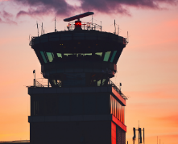
Flagship projects for ATM & Institutions in France
DSNA
DSNA
DGAC - DSNA
DSNA
AIRBUS
SESAR PJ34 (AURA)
Support to the specification and validation of a SWIM-based interface between UTM and ATM
SYSAT
Technical assistance with the definition and design of an advanced air traffic management system for control towers and approach control centers in Paris and mainland France
Read more
4-FLIGHT
System consulting and engineering for five en-route control centres. Delivering a brand-new system to improve the resilience and performance of air traffic management in France.
Read more
Assisting with operational concept development and validation of new ATS solutions (A-SMGCS, ATC tools, CDO, Free-Route) on SESAR R&D projects and very large-scale demonstrations
Fello'Fly
Advising on ACAS compatibility with Airbus Formation Flight
04.
ATM & Institutions

Slide 38
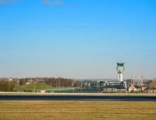
Flagship projects for ATM & Institutions in Europe
– Europe –
EUROPEAN DEFENCE AGENCY
– United Kingdom –
UKRI FUTURE FLIGHT CHALLENGE
– Europe –
SESAR JOINT UNDERTAKING (SJU)
– Belgium –
SKEYES
– Poland –
PANSA
Development of guidelines on the implementation of U-space and its impact on military missions and operations
Safety framework addressing the full aviation system using complex systems theory and bowtie analysis, centered on drones and future urban/regional air mobility
Read more
Support to the implementation of remote Digital Towers at Liege and Charleroi airports for Skeyes, the air navigation service provider
Consultancy, training and management support on SESAR2020 projects
Major study on cybersecurity of the future SWIM-enabled European ATM system
04.
ATM & Institutions

Slide 39
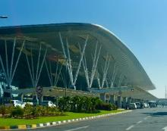
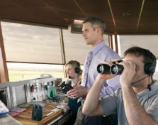
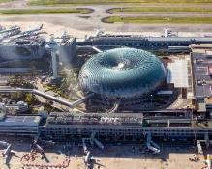
Flagship projects for ATM & Institutions in APAC/India
– PNG –
NATIONAL AIRPORT CORPORATION
– India –
INDIAN MINISTRY OF CIVIL AVIATION
– Hong Kong –
HONG KONG CIVIL AVIATION DEPARTMENT (CAD)
– Vietnam –
VIETNAM AIR TRAFFIC MANAGEMENT CORPORATION
– Singapore –
CIVIL AVIATION AUTHORITY OF SINGAPORE
Design of Air Traffic Control Towers at Port Moresby & Goroka Airports
Capacity building and institutional strengthening for DGCA and AAI
Technical design for Long Thanh ATC Tower - one of the tallest ATC towers in Southeast Asia
Consultancy on Airport Systems
Technical assistance in the fields of system engineering and safety covering ANS equipment upgrade and procurement for Hong Kong 3RS project
04.
ATM & Institutions

Slide 40
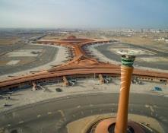
Flagship projects for ATM & Institutions elsewhere in the world
– Saudi Arabia–
SAUDI AIR NAVIGATION SERVICES (SANS)
– Cape Verde –
EMPRESA NACIONAL DE AEROPORTOS E SEGURANCA AEREA (ASA)
– Saudi Arabia–
ICAD
– Canada –
NAVCANADA
– Singapore –
CIVIL AVIATION AUTHORITY OF SINGAPORE
Project management consultancy for the implementation of the Saudi Future Airspace Concept; safety and business continuity activities and crisis management advisory
Technical and financial feasibility study of a unified single upper airspace in the COMESA region (eastern and southern African countries)
Identifying opportunities to alter airspace, reduce community noise exposure and improve efficiency in Toronto Airspace
Developing a plan for airspace, ATM/CNS infrastructure and operational change, in anticipation of future traffic levels and emerging regulatory requirements
Assistance to ATC systems integration at KAIA Airport
04.
ATM & Institutions

Slide 41
Communications | Aviation
communications.aviation@egis-group.com
www.egis-group.com
Photos © | Egis, Unsplash, Shutterstock, Benjamin Cazanova, Studio Cabrelli, Canva

