Slide 1
Airports

Slide 2
01
How we help
02
Sustainable futures
03
Consultancy & advisory
04
Design & engineering
05
Operation & maintenance
06
Contacts

Slide 3
How we help
01.

Slide 4
2022 key figures for Aviation
€70.4million
2022 Turnover
2022 TURNOVER
France
33
%
25%
Airport Operations & Management
Europe & Africa
38
€68.2M
2019
%
Middle East & South Asia
21
%
34%
Airport Consultancy
& Engineering
42%
ATM
€103.5M
2026 ambition
8
Americas & Pacific
%
+50
YEARS
of experience
20
AIRPORTS
1,700
AVIATION STAFF IN THE WORLD
+260
where Egis is shareholder or partner in operations
PROJECTS in 2022

Slide 5
A leader in optimising airport performance
BRINGING PROJECTS TO LIFE AT EVERY STAGE
DEMONSTRATED EXPERTISE
From business strategy, to performance, through to planning, designing, operating and maintaining sustainable infrastructure.
50 years’ experience delivering airport projects across the globe.
MORE THAN AIRPORT EXPERTS
UNIQUE UNDERSTANDING OF THE AIRPORT ENVIRONMENT
As recognised experts in Air Traffic Management, clients trust that the solutions we provide consider the entire airport operational environment, from ground to air.
Award-winning consultants and engineers, also operating airports for more than 30 years.
01.
How we help
5

Slide 6
Supporting airports from concept to operation
Consultancy
Engineering
Operations
LONG-TERM DECISION-MAKING, & STRATEGY​
MANAGEMENT OF OPERATIONS
TECHNICAL ASSISTANCE
OPERATIONAL CONSULTANCY
PROJECT & CONSTRUCTION MANAGEMENT
AIRPORT / AIRSPACE
DESIGN & ENGINEERING ​
01.
How we help

Slide 7
20 airports, decades of management expertise
our AIRPORT
NETWORK
20 AIRPORTS
4 CONTINENTS
8 COUNTRIES
KEY FIGURES 2021
11.6 million PASSENGERS
160,000 tonnes OF FREIGHT
1,400 EMPLOYEES
BELGIUM
ANTWERP
OSTEND
France
PaU
Bergerac
Brest
quimper
Cyprus
Larnaka
PaFos
Brazil*
Jacarepaguá
Campo de Marte
Ivory coast
Abidjan
Tanzania*
Zanzibar
AAKIA
Pemba
Congo
Brazzaville
Pointe Noire
Ollombo
French Polynesia
TAHITI FAA’A
Bora Bora
RAIATEA
RANGIROA
* Technical Service Agreement
01.
How we help

Slide 8
Delivering end to end services
LONG-TERM DECISION-MAKING & STRATEGY​
OPERATIONAL CONSULTANCY
AIRPORT
DESIGN ​& ENGINEERING
OPERATIONS MANAGEMENT & TECHNICAL ASSISTANCE
Strategic, economic and business planning
Change management
Feasibility and resilience studies
Sustainability management planning
Airport master planning
Environmental and noise impact studies
Operational concepts & requirements definition and evaluation
IT Systems & digitalisation support
Impact assessment on airport safety
Operational Readiness and Airport Transfer (ORAT)
Project and programme management
Airport infrastructure design & engineering
Equipment & system engineering
Work supervision
Operational excellence and asset management
CAPEX and OPEX optimisation
Airport infrastructure development
Strategy & route development
01.
How we help

Slide 9
Trusted partner to many of the world’s leading & emerging airports
Supporting airports with evaluating, planning and implementing strategic and operational initiatives to boost results and build resilience
SUSTAINABLE FUTURES
SHAPING FUTURE TRANSPORT
HARNESSING THE POWER OF YOUR DATA
OPTIMISING PERFORMANCE
Helping clients run more sustainable and efficient operations to address the impact of climate change and serve communities better
Using simulation modelling, BIM and Digital Twins to inform decision making and deliver operational improvements. Backed up by our internationally recognised cybersecurity expertise
Innovating with industry and academia to develop new transport concepts and technology that will shape future ‘integrated’ air travel and the seamless journey passengers expect
01.
How we help

Slide 10
Sustainable futures
02.

Slide 11
Acting on United Nations SDGs
INDUSTRY, INFRASTRUCTURE, & INNOVATION
CLIMATE
CITIES & COMMUNITIES
02.
Sustainable futures

Slide 12
Acting on United Nations SDGs
Airport design, plan & build
Airport master planning for sustainability
Energy-efficient buildings design
Hydrogen energy storage solutions
Low-carbon construction materials, equipment and recycling
Reducing airside emissions
ATM optimisation for ground, terminal, approach & en-route
Airspace sustainability modelling
Electric vehicle charging, GPUs and PCA
“take urgent action to combat
climate change and its impacts”
Landside sustainability
Passenger flow modelling and monitoring
Efficient HVAC and lighting systems
Smart Grid technology and renewable energy planning
02.
Sustainable futures

Slide 13
Acting on United Nations SDGs
Climate resilience planning
Sustainability policy, regulation and investment analysis
Electrical charging planning and infrastructure
Sustainability future-proofing
Data-driven optimisation
Airport Digital Twin data management
BIM-enabled design
Cyber-secure aviation
“build resilient infrastructure, promote inclusive and sustainable industrialisation and foster innovation”
Airport "beyond CO2" sustainability management
Assessments for ACA, ISO14001, ISO50001 and UN SDGs
Sustainability roadmaps
02.
Sustainable futures

Slide 14
Acting on United Nations SDGs
Air quality and noise
Noise-abatement procedures
Acoustic impact studies
Air quality monitoring and solutions
Circular economy
Nature-based land carbon sequestration
Ecosystem dimension analysis
Modular on-site waste treatment
Water management & reuse
“make cities and human settlements
inclusive, safe, resilient and sustainable”
Smart transportation
Air-rail-road integration solutions
Multimodal transport data management
Autonomous passenger shuttles
UAM integration
02.
Sustainable futures

Slide 15
Consultancy & advisory
03.

Slide 16
Long-term decision making & strategy
tangible improvements to performance, sustainability & resilience
Whatever the challenge, our experts develop effective strategies supported by regulatory, technical and operational know-how.
Capacity assessments and traffic forecasting
Security strategy and governance roadmaps
Sustainability management planning
Strategy and business planning
Investment planning and financing
Economic modelling and market analysis
Feasibility and resilience studies
03.
Consultancy & advisory

Slide 17
Long-term decision making & strategy
– UK –
Advisor since 2016, reducing the impact of aviation noise on local communities
Read more
Gatwick Airport
– France –
Airport development strategy to 2030
Clermont-Ferrand Auvergne Airport
– Hong Kong –
Advisory services looking at options to modify the night flight control regime whilst maintaining airport growth
Airport Authority of Hong Kong
03.
Consultancy & advisory

Slide 18
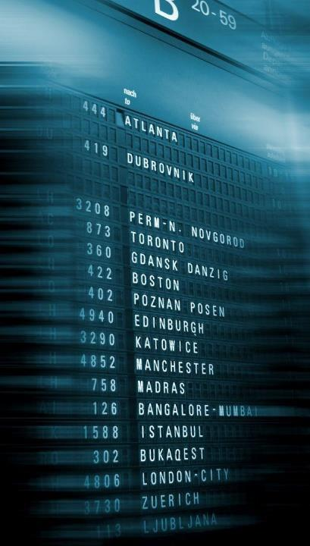
Operational consultancy
We have the unique ability to both deliver airport engineering projects and manage them through their lifecycle. By working with you over the long term, we help you to ensure that your assets are operationally, financially and environmentally efficient. You benefit from the latest, relevant technological innovations as soon as they emerge.
hands-on support to improve
Service Level Agreements (SLA)
Setting KPIs
Route development
Commercial contracts
Fixed operating equipment
Operational concepts definition & evaluation
SOPs
Business continuity
Safety & security
Wildlife management
IT systems & digitalisation
operational efficiency
03.
Consultancy & advisory

Slide 19
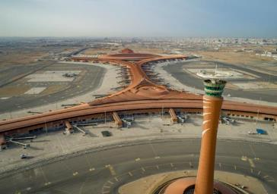
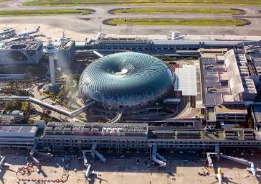
Operational consultancy
– Saudi Arabia –
Review and preparation of standard operating procedures (SOPs) and operations manuals for the new terminal
Jeddah Airport
– France –
Framework agreement to support Groupe ADP in the management of its airport IT systems projects
Aéroports de Paris
– Singapore –
Consultancy on Airport Systems
Civil Aviation Authority of Singapore
03.
Consultancy & advisory

Slide 20
Development & master planning
transforming organisations to meet
From master planning to Operational Readiness and Airport Transfer (ORAT), our plans help clients navigate the complex relationships between demand, capacity, sustainability, resilience, regulation and passenger flow.
business goals
Airport master planning
Environmental and noise impact studies
Sustainability management planning
Operational Readiness and Airport Transfer (ORAT)
Impact studies for policy, regulation and market-based incentives
Procurement strategy and planning
Organizational change management
Stakeholder management
03.
Consultancy & advisory

Slide 21
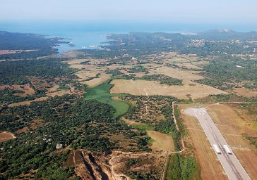
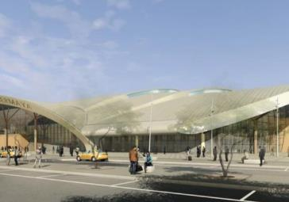
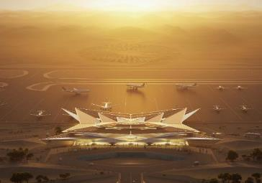
Master planning
– France –
Master plan for the development of four airports on the island of Corsica: Ajaccio, Bastia, Calvi, Figari
Collectivité de Corse
– Chad –
Master plan (including aeronautical studies) and Feasibility Studies for a passenger terminal, ATC tower and presidential pavilion sketches; air- and land-side preliminary and detailed design; design management and coordination of the overall project
New Djermaya International Airport
– Saudi Arabia –
Concept master plan, aeronautical study, concept and schematic design of a greenfield airport infrastructure, project and construction management, and ORAT services
Amaala Airport
03.
Consultancy & advisory

Slide 22
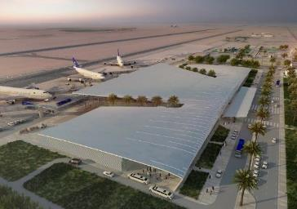
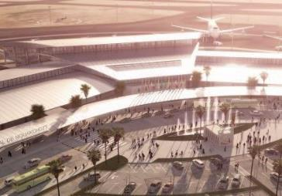
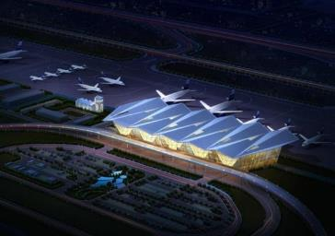
Greenfield airport
– Burkina Faso –
Technical studies and preparation of tender documents for the construction of the new airport infrastructure
International Airport of Ouagadougou – Donsin
– Mauritania –
ORAT support, setting up operational procedures, planning and running tests, providing staff training and capacity building, supervision of quality and efficiency of works construction, planning and equipment installation
Nouakchott-Oumtounsy International Airport
– Zambia–
Concept design and preliminary design phases reviews (drawings and technical documents) for the masterplan and for the entire airport infrastructure; Interior design of the passenger terminal and adjacent hotel
N’Dola Airport
03.
Consultancy & advisory

Slide 23
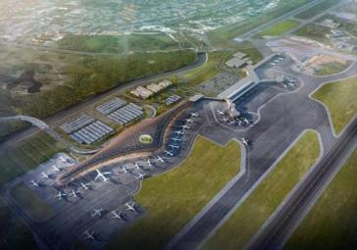
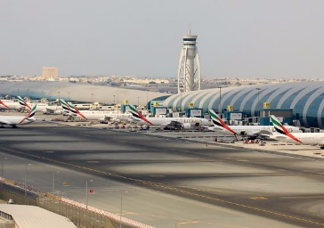
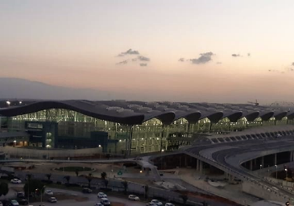
ORAT
– Panama –
Technical assistance to Operational Readiness and Airport Transfer (ORAT) for the commissioning of new T2
Tocumen Airport
– UAE –
ORAT support, technical and operational support during the closure of north runway, airport capacity studies and business continuity studies
DUBAI AIRPORTS
– Algeria –
Main ORAT consultant
Algiers Airport New Terminal
03.
Consultancy & advisory

Slide 24
Design & engineering
04.

Slide 25
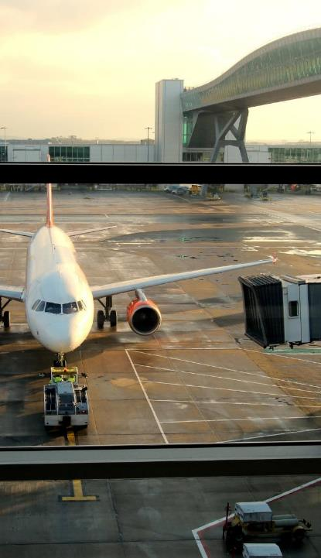
Airport & airspace design & engineering
Egis works in the most complex airport or airspace environments and develops sustainable and resilient solutions that help to imagine and build the future of aviation. With an end-to-end approach and trusted technical expertise delivered around the world, we use our consultancy skills to fuel the creative process, aligning smart vision with customer needs.
eco-design
& planning
on-time delivery
Energy use management and optimization
Safety management systems design and implementation
Information security system design and implementation
Sustainable development planning and implementation
Airport design
Airspace design and implementation
Terminal (passenger) simulation
Flight procedure design
Systems design and implementation
Operating procedure design
04.
Design & engineering

Slide 26
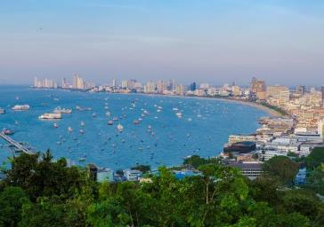
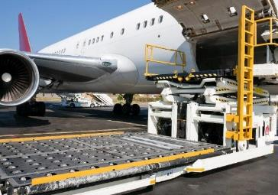
Design
– Thailand –
Infrastructure design, airfield lighting and protection areas for the Navaids on U-Tapao airport
Royal Thai Navy
– Bahrain –
Project management consultancy of a major cargo hub in the Middle East. Providing a flexible cargo infrastructure with phased options to accommodate future growth
Read more
Bahrain International Airport
– Vietnam–
Technical design for Long Thanh ATC Tower - one of the tallest ATC towers in Southeast Asia
VIETNAM AIR TRAFFIC MANAGEMENT CORPORATION
04.
Design & engineering

Slide 27
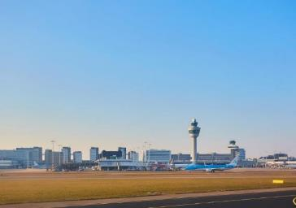
Airspace design
– Anguilla –
Airspace restructuring using new GNSS Instrument Approach Procedures
Clayton J. Lloyd International Airport
– France –
SYSAT: Technical assistance with the definition and design of an advanced air traffic management system for control towers and approach control centers in Paris and mainland France
Read more
DSNA
– The Netherlands –
Sensitivity analysis on aspects of a future Schiphol TMA route design
Read more
The Dutch Ministry of Infrastructure and Water Management
04.
Design & engineering

Slide 28
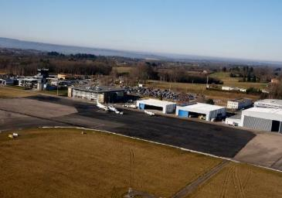
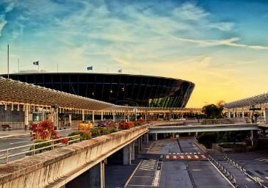
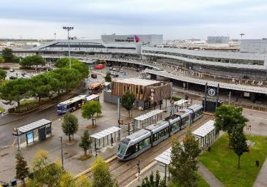
Equipment & systems
– France –
Project management of runway and airfield ground lighting systems upgrades
Limoges Bellegarde Airport
– France –
Project management (design phase) of new baggage handling system in terminals 2, 3
Nice-Cote d’Azur Airport
– France –
EPCM and works supervision of automated passenger screening
Toulouse-Blagnac Airport
04.
Design & engineering

Slide 29
Project & programme management
Egis has brought to life some of the most complex and safety critical projects in aviation. Our deep understanding of the industry and its stakeholders enables us to add value across the entire project lifecycle. We strive to build true partnerships with our clients, helping them to define their priorities and deliver long-term results and sustainable efficiencies which endure well past project completion.
end-to-end
project management
Stakeholder management
Construction management
Sustainability management
Operational readiness
Concept design
Procurement
Full programme management office (PMO)
Financial management
04.
Design & engineering

Slide 30
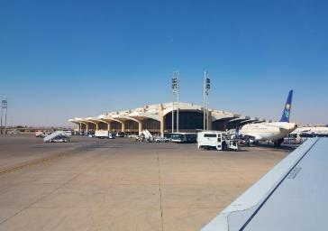
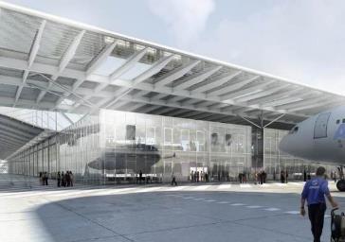
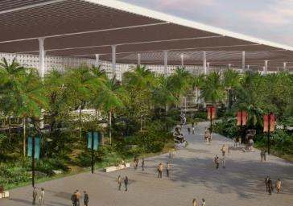
Project & programme management
– Saudi Arabia –
Project management consultancy services for airside projects
King Khalid International Airport
– China –
Development of technical functional program, concept design and site supervision for completion and delivery center in Tianjin
Airbus SAS
– India –
Project management consultancy for construction of new integrated passenger terminal including city-side development works
AirportS Authority of India
04.
Design & engineering

Slide 31
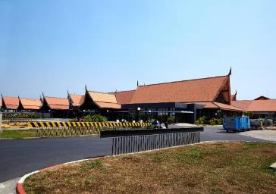
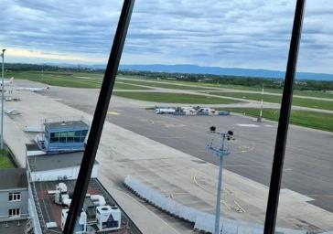
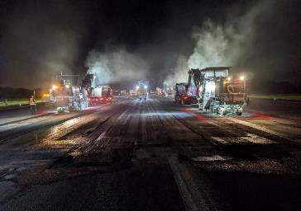
Runway rehabilitation
– Cambodia –
Technical assistance for runway overlay
Siem Reap, Sihanoukville and Phnom Penh Airports
– France –
Project management from complete design through to works supervision for the runway, stop ways, taxiways and apron. Similar aeronautical infrastructure works implemented at Toulouse-Blagnac, Limoges, Saint-Nazaire, Carcassonne and Pau airports in France.
Read more
Strasbourg Airport
– Guadeloupe –
Project management assistance to SAGPC for its structural reinforcement project for runway 12/30 and the Foxtrot ramp
Société Aéroportuaire Guadeloupe Pôle Caraïbes
04.
Design & engineering

Slide 32
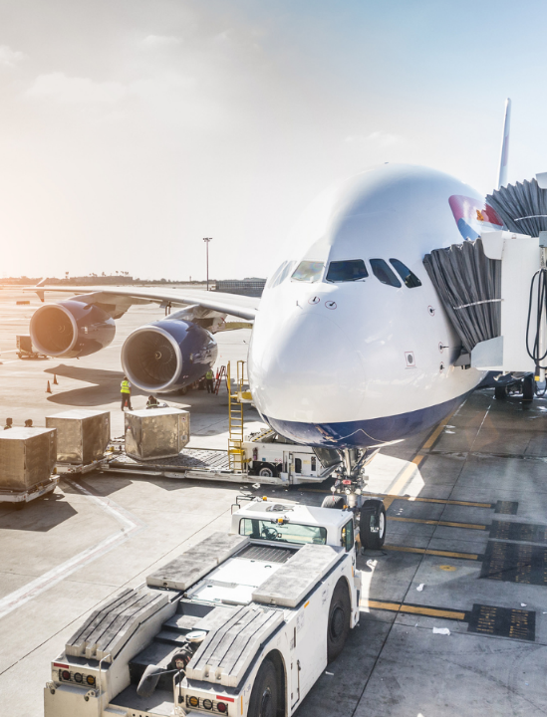
Operation & maintenance
05.

Slide 33
Airport management, development & engineering
end-to-end
project management
A world class airport infrastructure operator with a network of 20 airports on three continents. We work with customers and partners to improve the operational, financial and environmental performance of airports, and the experience of millions of passengers.
improving performance of airports across the world
Operational excellence and asset management
CAPEX and OPEX optimization and financial monitoring
Risk management and certification
Human resources management
Route development
Non-aeronautical revenue development
Strategy, master planning and airport capacity
Sustainability management planning
Airport infrastructure development, airside and landside
Implementation of turnkey fixed operating equipment and systems
05.
Operation & maintenance

Slide 34
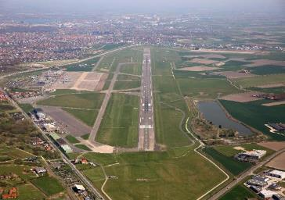
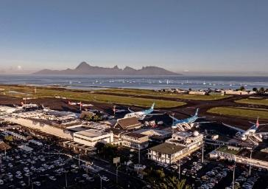
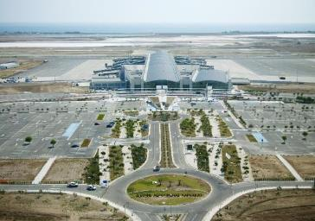
Airport operations
– Belgium –
Development of freight business via the "Cargo Village" project, implementation of a strategy to develop year-round traffic, Egis Soil.is carbon sequestration project and creation of a solar farm
Ostend-Bruges International Airport
– Tahiti –
Improvement of the passenger experience on departure and arrival: extension of the duty-free area in departures and renovation of the international arrivals hall
Tahiti-Faa’a International Airport
– Cyprus –
Major air- and land-side infrastructure investment, asset management, emergency exercises reinforcing airside safety and review of wildlife management plan
Larnaka International Airport
05.
Operation & maintenance

Slide 35
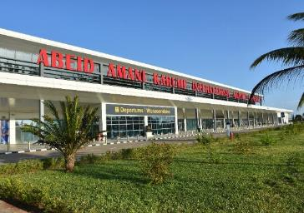
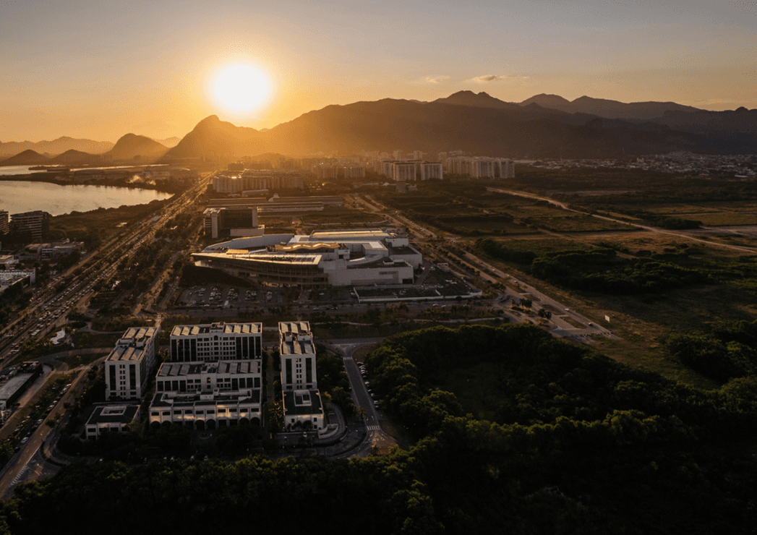
Technical assistance
– Zanzibar –
10-year support contract to the Zanzibar Airports Authority in the development and management of its airports (2021-2031)
Abeid Amani Karume International Airport
Pemba Domestic Airport
– Brazil –
Support to the new concessionaire for 2023, XP Asset Management, with running the two main business airports in Brazil
Jacarepaguá–Roberto Marinho Airport
Campo de Marte Airport
05.
Operation & maintenance

Slide 36
Communications | Aviation
communications.aviation@egis-group.com
www.egis-group.com
Photos © | Egis, Unsplash, Shutterstock, Benjamin Cazanova, Studio Cabrelli, Canva

