Slide 1


Financial Guidance for Service Personnel & Veterans
CPD slides
To provide specialist knowledge that might be required when offering financial guidance to armed forces personnel and veterans
Notes:
During the Personal Finance Society Symposiums in November 2016, we highlighted a new pro-bono initiative for injured service personnel which we launched in June 2017
This inititiative stems from an approach to the Society made by the On Course Foundation, a registered charity that helps injured armed forces veterans by introducing them to golf and encourages them to attend the Foundation’s ‘Golf Skills & Employment Events’ (which explores how golf can help them on the road to recovery and how the golf industry can provide employment such as golf course management, green keeping, marketing etc).
Following greater active engagement of our armed forces in recent years, the Foundation has become aware that many veterans are in receipt of substantial sums of money as a result of either payments from the Armed Forces Compensation Scheme or Insurance based payouts. In many cases, the amounts involved are of a level that the veteran has never had to contemplate or manage in the past and has placed them in a position of vulnerability, ranging from inappropriate advice that doesn’t have the best long-term interests of the veteran at its centre, sub-optimal advice that does not take into account specific circumstances, through to more blatant fraudulent activity and financial scams.
The Personal Finance Society is ideally placed to establish a process whereby veterans and serving armed forces personnel can be placed in a less vulnerable and better informed position via receipt of a free ‘pro bono’ guidance consultation with a member of the Personal Finance Society who is a fully qualified and regulated financial adviser. This may or may not then lead to the delivery of fee based regulatory advice with a personal recommendation as to a course of action and/or product transaction
In 2018 the initiative was extended to members of Blesma – the Limbless Veterans charity and members of the Forces Pension Society, regardless of their health or injuries. A Strategic Objective of the Personal Finance Society was to extend ForcesMonePlan to cover all service personnel in the UK (injured or not) and in Autumn 2019 the initiative expands to ‘Veterans Gateway’ an online facility providing the first point of contact for veterans seeking support. It connects veterans and their families with a range of local support organisations – both within and outside the Armed Forces sector.

Slide 2

Welcome
Welcome to this CPD slide pack and notes. These have been designed to provide specific information relevant to financial guidance for armed forces personnel and veterans.
We hope we have struck the right balance between key information and not too much unnecessary detail. Where relevant, we have provided additional information in the notes section of each slide and signposted through to sources of further information.
Thank you for giving up your valuable time in support of this important initiative

Slide 3
Learning Objectives
Understand key aspects of the Personal Finance Society pro bono initiative entitled Forces MoneyPlan and your role within it
Appreciate the details and working of the Armed Forces Compensation Scheme and the role of personal injury and compensation trusts
Be able to access primary sources of further information and support relevant to both serving and injured forces personnel and veterans

Slide 4
Content
Forces MoneyPlan
  What is ‘Forces MoneyPlan’?
  Who are the On Course Foundation?
  Who are Blesma – The Limbless Veterans?
  Who are the Forces Pension Society?
  Who is the ‘Veterans Gateway’?
  How will the pro bono initiative work?
  What documentation should I use?
Existing organisational and online support for armed forces, veterans and families
Armed forces compensation
Capacity and mental health
Pensions, benefits and concessions for armed forces, veterans and family
Legal representation
The bigger picture

Slide 6

What is
http://www.thepfs.org/about/inside-the-pfs/forcesmoneyplan/
Notes:
Forces MoneyPlan is the name the Personal Finance Society has given to the pro bono initiative it has established to provide generic financial guidance to sick and injured service personnel and veterans. This pro bono initiative follows on from the success of the MoneyPlan pro bono offering of generic financial guidance run in conjunction with Citizens Advice.
Forces MoneyPlan is designed to provide free generic financial guidance from a fully qualified and regulated financial adviser and member of the Personal Finance Society. This may or may not lead to the delivery of fee based regulated financial advice with a personal recommendation as to a course of action and/or product transaction.
WE SUGGEST YOU FAMILIARISE YOURSELF WITH THIS PAGE WITHIN THE PFS WEBSITE:
http://www.thepfs.org/about/inside-the-pfs/forcesmoneyplan/

Slide 7

Who are
www.oncoursefoundation.com
Notes:
The On Course Foundation is a leading armed forces charity that offers injured Service personnel and veterans the opportunity to participate in golf on a level playing field with everyone else, either as a player or through employment in the golf industry. On Course Foundation was officially launched on 2 July 2010 at the Royal Household Golf Club at Windsor Castle.
Why golf?
Golf occupies a unique position as one of the few sports where participants of all skills and physical abilities can play together on a level playing field owing to the official handicap system. It offers injured Service personnel not only a sporting challenge but for those leaving Service, an array of attractive career opportunities also.
The benefits of playing golf offer a key part in physical rehabilitation, improving both balance and limb coordination. Camaraderie, competitive spirit and concentration are important too, supporting the psychological recovery of their members and helping them find confidence within themselves.
WE SUGGEST YOU FAMILIARISE YOURSELF WITH THIS SITE:
http://www.oncoursefoundation.com/who-we-are

Slide 8

Who are
www.blesma.org
Notes:
Blesma, a military charity for Limbless Veterans, was founded in the aftermath of the First World War and helps all serving and ex-Service personnel who have lost the use of limbs or eyes, to rebuild their lives by providing rehabilitation activities and welfare support.
Blesma has a long and proud track record in seeking and achieving improvements in the War Pension, in the Armed Forces Compensation Scheme and in improvements in prosthetic services so that their members can be as mobile as possible - thus able to lead independent and fulfilling lives
WE SUGGEST YOU FAMILIARISE YOURSELF WITH THIS SITE:
http://www.blesma.org/

Slide 9

Who are
https://forcespensionsociety.org/about-us/
Notes:
Founded in 1946, The Forces Pension Society is an independent, not-for-profit organisation that acts as the pension watchdog for the whole military community. The Society gives advice about Armed Forces pensions. See Slide 45.
Forces MoneyPlan consultations can provide Forces Pension Society members with a wide range of assistance, including guidance on day to day finances and debt, future planning, the implications of each of the many different types of savings, investment and pension products available, retirement options, risk, personal injury trusts, considerations on approaching retirement, buying a home, starting work, changing jobs, having a baby, starting a family, redundancy and navigating the complexities of sourcing and funding care, whether state or self-funded.
WE SUGGEST YOU FAMILIARISE YOURSELF WITH THIS SITE:
https://forcespensionsociety.org/about-us/

Slide 10

Who are
https://www.veteransgateway.org.uk/
Notes:
In May 2017 a new service offering a single point of contact for Veterans seeking help was launched, called Veterans Gateway
Veterans’ Gateway is made up of a consortium of organisations and Armed Forces charities, including The Royal British Legion, SSAFA – the Armed Forces charity, Poppyscotland, Combat Stress and Connect Assist.
Their connection with additional key referral partners and information organisations – both within and outside the Armed Forces sector – means they can direct personnel to the right organisation who can help.
Funded by The Armed Forces Covenant, this is the first time a group of this kind has come together formally to deliver a service to help the Armed Forces community.
‘
Forces MoneyPlan can be found on their website under ‘Local Support’
WE SUGGEST YOU FAMILIARISE YOURSELF WITH THIS SITE:
https://www.veteransgateway.org.uk

Slide 11
How will the initiative work in practice?
‘Client’ matched with PFS volunteer
PFS volunteer contacts client to agree meeting date/time
PFS volunteer issues Terms of Engagement (including any pre meeting requirements )
Consultation takes place
(by phone, Skype or face to face)
PFS volunteer issues ‘Options & Priorities’ Report
(within 7 days)
Client
provides basic satisfaction feedback
STEP 1
STEP 2
STEP 3
STEP 4
STEP 5
STEP 6
Client journey
Notes:
Service personnel and veterans referred to this initiative will benefit from your time and expertise via a 6 step process.
Step 1 – the client will be able to provide their contact details through a webpage promoted by each of our Armed Forces Partners and supported by the Personal Finance Society. The Personal Finance Society will match the client with a local adviser
Step 2 – The adviser will contact the client, make reference to this scheme (Forces MoneyPlan) and arrange a mutually convenient appointment.
Step 3 – the client will be issued with a Statement of Engagement by the pro bono adviser.
Step 4 – the generic financial guidance consultation session will take place as agreed
Step 5 – the client will receive a Financial Options and Priorities report together with a Feedback Form within 7 days of the consultation
Step 6 – the client will send the Feedback Form direct to the Personal Finance Society
Full details of the client journey and how the initiative will work in more detail is available within the ‘Handbook for Financial Advisers’

Slide 12

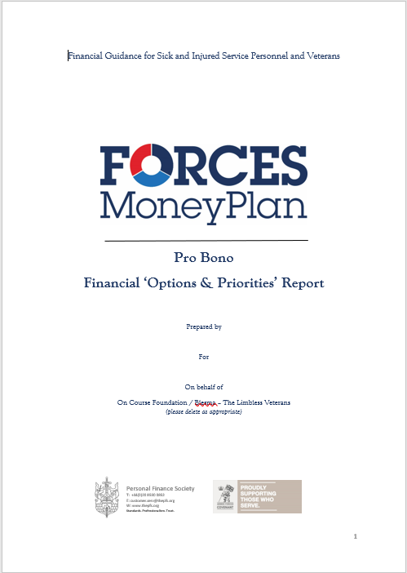

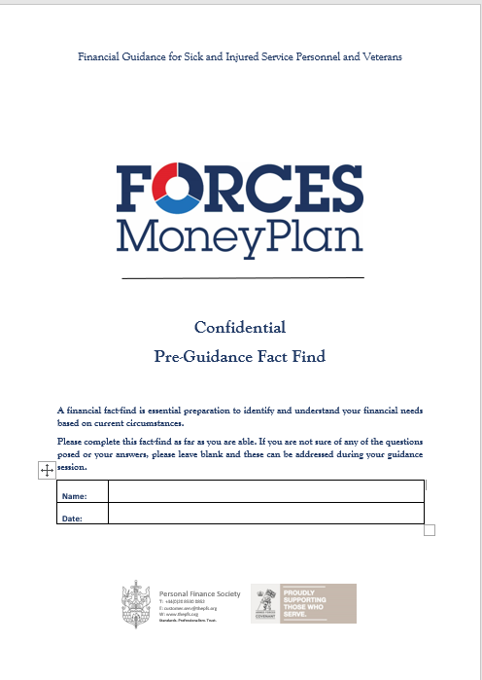
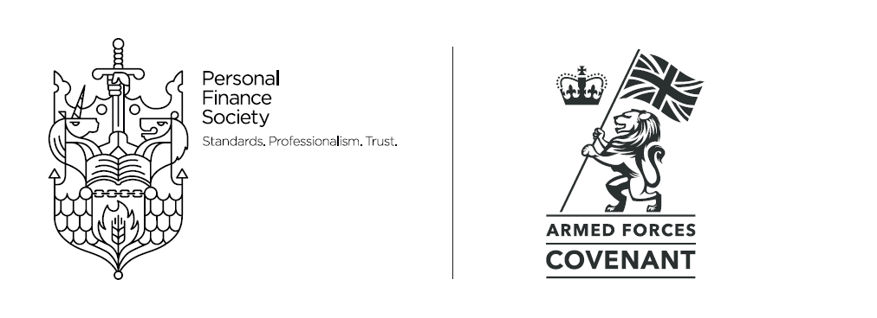
What documentation do I need to use?
Please ensure you have read each document and are comfortable with their content
and the obligations they place on you.
Notes:
It is important we operate a degree of quality control to protect both volunteer advisers and the recipients of guidance delivered through the initiative.
As such, in addition to commitment to an agreed process of delivery, and confirmation of reading this CPD slide deck and notes, you will be required to familiarise and use the following 4 key documents :
Handbook for Financial Advisers
Pro Bono Financial Options and Priorities Report
Statement of Engagement
Feedback Form

Slide 13

The Handbook
The Handbook is the principle document for the
volunteer adviser that describes the workings of the
initiative and his/her role within it. It provides details around
how the initiative will work, high level principles that need
to be adhered to and the nature of the agreement
between the Personal Finance Society and the volunteer
adviser.
Of critical importance is adherence to the definition of
Generic Financial Guidance and the ‘Break Clause’ to
ensure that there is a natural break between the pro
bono guidance session and any subsequent fee-based regulated financial advice that may subsequently
be requested by the client.

Slide 14
The Report
The Report has been designed to provide some prescribed
general guidance as well as space for the financial adviser to include whatever commentary they see fit based on the consultation itself. It consists 5 sections:
Generic principles/rules of thumb underpinning financial wellbeing
Things for the client to consider following the generic financial guidance consultation
Further sources of reliable, independent financial information
Things the client should be aware of (e.g. scams)
What the client should do next
Sections 1 ,3 ,4 and 5 are in a prescribed format that
should not be changed

Slide 15
Statement of Engagement
The Statement of Engagement is designed to
confirm key aspects of the consultation, manage the
client’s expectations and request information in
advance of the meeting.
The content should be sent to the client either via
e-mail or letter in advance of the consultation.

Slide 16
Feedback
The Feedback Form is designed to inform the
Personal Finance Society of the effectiveness of
this initiative. We shall use this to try and
understand the value of the generic financial
guidance given, the clients overall experience
and an indication of what the client did or intends
to do next
Whilst we cannot ensure that the form is
returned to us, we would ask that you
encourage the client to do so in order that we can
improve the initiative in any areas that are identified
as needing attention, as well as quantifying the
need for regulated financial advice.

Slide 17
Existing organisational and online support for armed forces, veterans and families
Notes:
This section provides details of key services either provided by, endorsed or recognised by the Ministry of Defence for service personnel and/or veterans.

Slide 18

Good places to start
An overview of support services for military and defence personnel and their
families is available via:
https://www.gov.uk/topic/defence-armed-forces/support-services-military-defence
personnel-families
STOP PRESS: July 2019:
A new personalised care framework has been agreed between the Ministry of Defence and NHS England for the UK’s most seriously wounded Armed Forces personnel
The Ministry of Defence has recently launched a new website Discover My Benefits

Slide 19
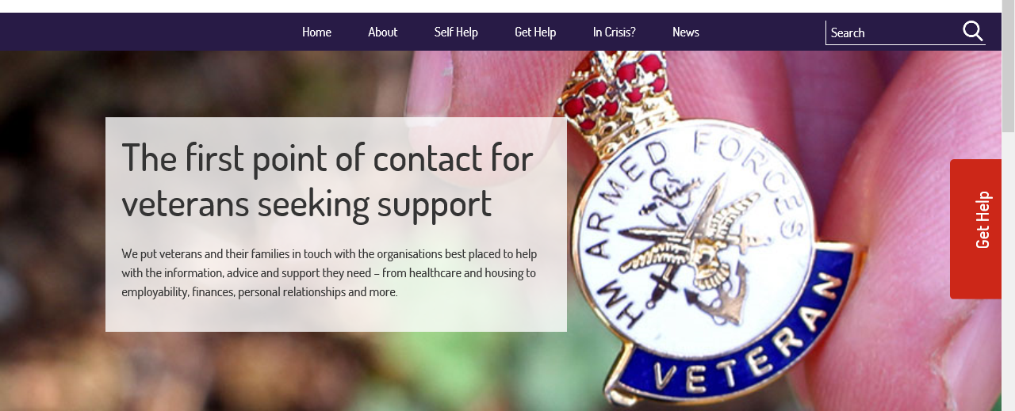
https://www.veteransgateway.org.uk/
Notes:
With over 2000 charities and organisations providing support to Veterans in the UK, navigation to find appropriate help is difficult.
On 22nd May 2017 a new service offering a single point of contact for Veterans seeking help was launched, called Veterans Gateway
Take a look at the following: https://www.veteransgateway.org.uk/
The service is delivered by a consortium of charities led by The Royal British Legion, and includes Poppyscotland, Combat Stress, Connect Assist, the Ministry of Defence and SSAFA - the Armed Forces Charity.
The service is funded by The Ministry of Defence, with £2m coming from Covenant Fund.

Slide 20

Who are Veterans UK
https://www.gov.uk/government/organisations/veterans-uk
Notes:
Veterans UK is part of the Ministry of Defence and helps ex-service personnel get appropriate support from Government, local authorities, independent bodies and the charity sector.
Veterans UK administers the armed forces pension schemes and compensation payments for those injured or bereaved through service. It also provides welfare support for veterans of any age, and their families through the Veterans Welfare Service and the Veterans UK helpline: 0808 1914 2 18.
Specifically, it is responsible for:
Armed Forces Compensation Scheme (AFCS)
War Disablement Pension
Armed Forces Pensions
Veterans Welfare Service (VWS)
Ilford Park Polish Home

Slide 21
The Veterans UK Helpline
Email veterans-uk@mod.uk
Freephone (UK only): 0808 1914 2 18
Notes:
The helpline staff offer specific advice on war disablement pension and armed forces compensation scheme claims. The helpline also offers advice on other issues including benefits, pensions, loans and grants, emergency accommodation, finding a job, retraining, health issues, welfare concerns, service records and medals.
They also have up to date information on central/local Government and ex service organisations, and other voluntary groups.
Veterans UK
Tomlinson House
Norcross
Thornton Cleveleys
FY5 3WP
Email veterans-uk@mod.uk
Freephone (UK only): 0808 1914 2 18
Telephone (overseas): +44 1253 866 043
8.00 am to 5:00 pm Monday to Friday
When the helpline is closed, callers will be given the option to be routed to Combat Stress or The Samaritans 24hr helpline.

Slide 22

Veterans Welfare Service
The Veterans Welfare Service (VWS) is part of the Ministry of Defence’s Veterans UK support function and provides one-to-one welfare advice across the UK and Republic of Ireland. It facilitates access to all appropriate services using a caseworker approach that offers professional help and guidance where a change of situation results in a welfare need, for example:
Leaving service
Bereavement
Changes in disablement
Changes affecting income or finances
Changes affecting housing
https://www.gov.uk/government/publications/a-guide-to-the-veterans-welfare-service

Slide 23

What is SIIAP?
www.siiap.org
Notes:
The Services Insurance and Investment Advisory Panel (recognised by the MOD) is made up of individuals and firms who are insurance and independent financial advisers specialising in providing services to members of HM Forces.
All Member Firms must be authorised and regulated by the FCA in the UK and adhere to the SIIAP Code of Practice.
A directory of members is available via the website:
http://siiap.org/

Slide 24
Armed Forces Compensation
Notes:
As part of your engagement with service personnel and veterans via Forces MoneyPlan, you may encounter individuals who have received compensation payments either from schemes operated by the Ministry of Defence (eg. The Armed Forces Compensation Scheme – AFCS) or from private insurance (eg. PAX or SLI).
The following slides provide an overview and source material for both.

Slide 25
Armed Forces Compensation
Overview (1)
There are a number of compensation schemes available to UK serving and former
serving personnel who are injured as a result of their service in the armed forces. The
scheme that applies to each individual will depend on when and where they served, as
follows:
The Armed Forces Compensation Scheme
Where the illness or injury was caused as a result of service on or after 6 April 2005. The
individual does not need to have left the armed forces before claiming
The War Pensions Scheme
Where the individual is no longer serving and their disablement was caused as a result of
service in the armed forces before 6 April 2005
The Criminal Injuries Compensation (Overseas) Scheme
Where the individual or eligible dependants are the innocent victim of a crime of violence
while serving overseas

Slide 26
Armed Forces Compensation
Overview (2)
Further information can be sourced via the following link:
www.gov.uk/government/publications/armed-forces-compensation/armed-forces-
compensation-what-you-need-to-know
Update press release 17/7/18:
http://www.ftadviser.com/pensions/2018/07/02/armed-forces-pension-scheme-to-change-death-benefit-rules/?utm_campaign=FTAdviser+news&utm_source=emailCampaign&utm_medium=email&utm_content=
Including:
Armed Forces Compensation Scheme (AFCS); an overview
Armed Forces Independent Payment (AFIP)
Survivors Benefits
Payment arrangements
Reasons for not receiving an award
What to do if their condition worsens
Other benefits that may be available
Can they claim a fast payment?
AFCS forms
Further Information

Slide 27
The Armed Forces Compensation
Scheme (1)
The Armed Forces Compensation Scheme (AFCS) provides compensation for any injury,
illness or death which is caused by service on or after 6 April 2005. The AFCS is a no-
fault scheme which means payment is made without admitting fault. It is entirely separate
from any other personal accident cover which is not taken into account when
determining an AFCS award
There are two main types of AFCS benefits:
Lump sum payments
Range from £1,200 up to £570,000 (tax free) reflecting the severity of the injury/illness
(multiple injuries from the same incident receive compensation for each injury up to a
maximum of £570,000)
Guaranteed Income Payments (GIP)
For those with more serious injuries and illnesses, AFCS also provides an income
stream known as GIP. This is a tax free, index linked monthly payment.

Slide 28
The Armed Forces Compensation
Scheme (2)
Further information can be sourced via the following link:
www.gov.uk/government/publications/armed-forces-compensation/armed-forces-
compensation-what-you-need-to-know
Including:
Who is eligible?
Time restrictions for claims
What can be claimed for?
Types of awards
How to submit a claim
Information needed to support your claim
How your claim will be processed
Legislation
How awards are calculated

Slide 29
The Armed Forces Compensation Scheme (3)
AFPC awards are one element in a co-ordinated range of services, benefits and
programmes provided by government and delivery agencies.
Personal Insurance
Any payments paid from personal accident of life insurance cover is paid in addition to
any AFCS award
NHS prescriptions
Individuals may receive free NHS prescriptions which relate to the injury or illness for
which they have received an AFCS award
Universal Credit
All AFCS awards are exempt from the financial assessment for Universal Credit
Social Care
AFCS lump sums are exempt from the Local Authority social care financial assessment
when put into a personal injury trust.
Notes:
In addition:
IVF Treatment
Under the AFCS Service and ex-Service personnel with serious traumatic physical injury to genitalia or groin due to service which results in infertility will receive a supplementary award where clinically appropriate, individuals with these injuries, where infertility has been accepted as due to service, are entitled to receive the number of full cycles of IVF treatment that the NHS trust responsible for the individual's treatment determines corresponds to best practice, up to a maximum of three full cycles of treatment.
Travel Concessions
Individuals who have received at least one AFCS award at tariff levels 1 – 8 who have a permanent mobility-related injury may be automatically eligible, without further assessment, to free bus travel. They may also receive a ‘blue badge’ which entitles them to free parking. More information can be obtained from the individual’s local authority or via www.gov.uk.
For a statement of policy for the MOD compensation schemes the following link provides access to the relevant Joint Service Publication (JSP) providing direction that must be followed in accordance with statute or policy mandated by defence or on defence by Central Government.
https://www.gov.uk/government/publications/joint-service-publication-jsp-765-the-armed-forces-compensation-scheme

Slide 30
The War Pension Scheme
The WPS compensates for any injury, illness or death which occurs before 5 April 2005.
Further information can be sourced via the following link:
www.gov.uk/government/publications/war-pension-scheme/war-pension-scheme-what-
you-need-to-know
Including:
Who is eligible?
Time restrictions for claims
What can be claimed for
How to submit a claim
Information needed to support a claim
How a claim will be processed
Legislation
Types of awards and how they are calculated

Slide 31

The Criminal Injuries
Compensation (Overseas) Scheme
Since 1979 the Ministry of Defence has operated a
compensation scheme for service personnel
and their accompanying dependants which makes
payments to innocent victims of crimes of violence.
The scheme covers those serving overseas and
deliberately mirrors the scheme operated by the
Ministry of Justice which compensates victims of
crime in the UK. This ensures they and their families
do not suffer a disadvantage as a result of service
Compared to civilian victims of crime
Further details can be sourced via:
www.gov.uk/government/uploads/system/uploads/at
tachment_data/file/507473/CICO_Leaflet.pdf

Slide 32
What is The Armed Forces
Independent Payment (AFIP)
This is a new benefit (effective 8 April 2013) introduced by the Ministry of Defence in
conjunction with the Department for Work and Pensions and designed to provide financial
support to service personnel and veterans seriously injured as a result of service to
cover extra costs they may have as a result of their injury.
It is designed to ensure that individuals receive a holistic package of support rather than being assessed separately for different benefits (eg Personal Independence Payment, Disability Living Allowance and/or Attendance Allowance)
Further details can be sourced via:
www.gov.uk/government/publications/faq-on-the-armed-forces-independent-payment

Slide 33
Private Insurance Payouts
The following private insurance schemes have been created especially for British Armed
Forces and as such you may come across individuals who still have such a product or
(in respect of some of the products) have received a payout. Such schemes are optional
and do not affect entitlements under the Armed Forces Pensions or Compensation
Schemes
PAX Insurance
The PAX personal accident plan with optional life and critical illness is arranged under
contract with the MOD. Pax Insurance is a trading name of AON UK Ltd. Cover can be
extended/transferred to a new plan on leaving HM Forces
Service Life Insurance (SLI)
Specialist military life insurance arranged under contract with the MOD – cover
maintained for duration of policy and after leaving HM Forces,

Slide 34
Personal Injury Trusts (1)
What is a personal injury trust?
Personal injury trusts go by many names, such as ‘special needs trusts’, ‘trusts for
disabled people’ and ‘compensation protection trusts’. They take different forms – bare
trusts, life interest trusts, discretionary trusts – but whatever the label and whatever form
it may take, any trust funded by compensation for personal injury is a personal injury
trust.
Personal injury in this context is widely defined – as well as physical injuries, it can
include both physical and mental diseases. Compensation is similarly widely defined,
including lump sum gratuities under the War Pensions schemes and payments from the
Armed Forces Compensation Scheme.
There is no limit on the amount that can be placed into a personal injury trust.

Slide 35
Personal Injury Trusts (2)
Why a personal injury trust?
The main purpose of a personal injury trust is to preserve a claimant’s entitlement to
means-tested state benefits and other means-tested support and care. Sums held in
personal injury trusts are disregarded in the assessment of eligibility for means-tested
benefits.
Since The Social Security (Miscellaneous Amendments (No.4)) Regulations 2006 came
into force on 2 October 2006, any personal injury compensation received by a claimant,
or his or her partner, will be disregarded for means-tested benefits purposes for a period
of 52 weeks, beginning on the day the claimant first received the personal injury
payment.
Although the benefits agency will usually give up to 52 weeks from when the claimant first
receive either an interim or final settlement, it is often best practice to set up a Trust as
soon as they receive their compensation.
Notes:
Consideration should be given to establishing a personal Injury Trust where an individual has received a significant compensation payment.
Legal advice can be sought from the Royal British Legion Solicitors Group (see slide 45)

Slide 36
Capacity and Mental Health

Slide 37
Implications of the Mental
Capacity Act (MCA) 2005
When providing guidance, the Act and associated Code of Practice will
provide some useful principles to consider:
A person must be assumed to have capacity unless it is established that they lack capacity.
A person is not to be treated as unable to make a decision unless all practicable steps to help him to do so have been taken without success.
A person is not to be treated as unable to make a decision merely because he makes an unwise decision.
An act done or a decision made, under this Act for, or on behalf of, a person who lacks capacity must be done, or made, in their best interests.
Before the act is done or the decision made, regard must be had as to whether the purpose for which it is needed can be as effectively achieved in a way that is less restrictive of a person’s rights and freedom of action.

Slide 38
Implications of the Mental
Capacity Act (MCA) 2005
Should at some future point you agree to deliver regulated financial advice to someone
who has received a pro-bono guidance session through Forces MoneyPlan, as with any
other client, you will need to have due regard to the Mental Capacity Act Code of Practice
as well as regulatory requirements to treat customers fairly and the principles of good
practice set out by the Financial Conduct Authority.
Further details in respect of the MCA can be found via:
https://www.gov.uk/government/collections/mental-capacity-act-making-decisions

Slide 39
Mental health support for the UK armed forces
Serving personnel
The uniformed and civilian medical and dental personnel from all three services are known collectively as the Defence Medical Services (DMS)
Personnel can be treated for mental health problems by their medical officer in their unit medical centre, or referred to specialist mental healthcare services.
‘Combat Stress/Rethink’ offers a 24 hour free phone helpline to provide emotional support, a listening ear and signposting of services – Tel: 0800 138 1619
Further details can be found online : www.gov.uk/guidance/mental-health-support-for-the-uk-armed-forces
Veterans
Discharged servicemen and women are able to access the DMS up to 6 months after leaving the armed forces.
‘Help for Heroes Hidden Wounds’ provides free and confidential support to Veterans, and their families who are suffering with anxiety, depression, stress, anger or alcohol abuse.

Slide 40
The Veterans and Reserves
Mental Health Programme
The Veterans and Reserves Mental Health programme (VRMHP) provides assessment and treatment advice for veterans (who have deployed since 1982) and reserves who have been deployed overseas since 1 January 2003 as a reservist, and believe that their deployment may have affected their mental health.
All veterans referred to the VRMHP will receive a full psychiatric assessment completed by a consultant psychiatrist; this assessment report is then sent on completion to the veteran’s GP and if involved, the local mental health service, with advice on further treatment and care. Reserves whose condition is found to be operationally related and of a nature that can be treated within the resources of the Defence Medical Service (DMS) can access treatment in a MOD UK Department of Community Mental Health (DCMH) and will be offered out-patient treatment at a DCMH closest to where they live.
Referrals for reservists and veterans should be directed to DCMH Colchester:
Veterans and Reserve Mental Health programme, DCMH Colchester , Merville Barracks,Read Hall House,COLCHESTER Essex CO2 7UT

Slide 41
Pensions, benefits and concessions for armed forces, veterans and families

Slide 42

Pensions, Benefits and
Concessions
Citizens Advice provides a useful
summary of benefits and concessions
for armed forces,veterans and their
families. This includes information in
respect of:
Benefits in the UK and abroad
Council Tax relief
Armed Forces pensions
Help with school fees and childcare costs
Free and reduced travel costs
Forces discounts
https://www.citizensadvice.org.uk/benefits/armed-forces-and-veterans/benefits-and-concessions-for-the-armed-forces-veterans-and-their-families/

Slide 43
Serving Members Pensions
The Armed Forces Pension Scheme 2015 (AFPS 15) was introduced on 1 April 2015.
If a serving member of the armed forces (including the reserve forces) their
pension will have been transferred to AFPS 15. This is unless they qualified for
transitional protection, which meant they could stay with one of the previous schemes.
Further information in respect of AFPS 15 and all previous schemes are available via:
https://www.gov.uk/government/publications/afps-2015-what-you-need-to-know
Or
https://www.gov.uk/government/publications/armed-forces-and-reserve-forces-pension-
schemes-guidance-booklets

Slide 44
Veteran’s Pensions
There are currently 3 Armed Forces Pension Schemes (AFPS) available to service
leavers:
AFPS 75
AFPS 05
AFPS 15
There are some fundamental differences between the schemes that cover both retired
benefits and dependants benefits.
For further details (including compensation payments for injury and illness prior to 6 April
2005 known as ‘Armed Forces Attributable Benefits’) go to:
https://www.gov.uk/guidance/pensions-and-compensation-for-veterans
Notes:
Over the last few years Armed Forces pensions have become increasingly complex. Once there was a single scheme; now there are four mainstream schemes and although all but one are closed to new joiners, most of those with service before 2015 will have at least two separate pension entitlements, potentially paying out different sums at different times. Getting a satisfactory explanation of entitlements is difficult, and although MOD provides a number of tools to help (such as the on line calculator) these have limitations
AFPS 75
AFPS 75 pension benefits are based on rank and length of service. All personnel serving between 6 April 1975 and 6 April 2005 will have served under the AFPS 75 scheme.
AFPS 05
AFPS 05 pension benefits are based on length of service and final salary and personnel who joined after 6 April 2005 will be serving under the AFPS 05 scheme. However, personnel serving between July 2005 and March 2006 were given the option to move to the AFPS 05 as part of the Offer to Transfer process.
AFPS 15
AFPS 15 is a defined benefits career average re-valued earnings (CARE) scheme. Every year, the MOD adds an amount equal to 1/47th of annual pensionable earnings for that year, to an individual ‘pension pot’.
RFPS (https://www.gov.uk/guidance/pensions-and-compensation-for-veterans#history)
The Reserve Forces Pension Scheme is for those employed on Full Time Reserve Service (FTRS) appointments including additional duties commitment; or anyone who is mobilised under Paragraph 4, 5 or 6 of the Reserve Forces Act 1996, or a correspondence power under the Reserve Forces Act 1990

Slide 45
Forces Pension Society
Founded in 1946, The Forces Pension Society is an independent, not-for-profit
organisation that acts as the pension watchdog for the whole military community.
The Forces Pension Society can give advice about Armed Forces pensions.
You can find out more information by contacting them at:
          The Forces Pension Society
          68 South Lambeth Road
          London SW8 1RL
          Telephone: 020 7820 9988
          Fax: 020 7820 7583
          Email: memsec@forpen.co.uk
          Website: www.forpen.org
Notes:
The Forces Pension Society is a WATCHDOG, scrutinising the actions of the MOD and government to make sure that they apply the rules concerning Armed Forces pensions fairly and consistently and that the rules themselves are appropriate. Much of this work is done behind the scenes, but when necessary they will campaign publicly for change. The Society sits as an independent representative on the MOD Pension Board and also on the Public Sector Pensions Council alongside various public sector trades unions. The Society is also represented at the Customer Advisory Group run by Veterans UK, the MOD Agency that administers Armed Forces Pensions. The Society acts as a watchdog for the whole Armed Forces community, not simply its membership. To ensure they can fulfil this role independently the Society does not seek or receive any public funds. It is also structured as a not for profit membership society rather than a charity, to give it the greatest freedom of action when campaigning. The Society is therefore like a charity but not a charity, like a trade union but not a trade union.
The Society also acts as a GUIDEDOG for its members. This means answering their questions about their particular pensions issues, enabling them to seize control of their destiny and make informed decisions about their future. Armed Forces pension schemes are consciously used as a manning and retention tool and also provide an income stream earlier than most civilian schemes. Queries range from those who simply want to understand their entitlement better or want a forecast verified to those who want to know details about a particular issue affecting them. This could be how to commute their pension or add to it, the implications of FTRS service, divorce, retiring at a particular date, medical awards, Annual Allowance, Life Time Allowance or how to make a complaint or resolve a mistake.

Slide 46

The Motability Scheme
You may come across this scheme that provides help with leasing a car in exchange
for the Armed Forces Independence Payment
http://www.motability.co.uk/about-the-scheme/
Notes:
The Motability Scheme can help with leasing a car, powered wheelchair or scooter.
Individuals will need to be getting one of the following:
the higher rate of the mobility component of DLA
War Pensioners’ Mobility Supplement
Armed Forces Independence Payment
the enhanced rate of the mobility component of PIP
The Motability Scheme enables disabled people to get mobile by exchanging their
mobility allowance (above) to lease a new car, scooter or powered wheelchair.

Slide 47
Legal Representation

Slide 48


Legal Representation
Notes:
Should you identify a ‘client’ need for legal representation , we suggest members of the Royal British Legion Solicitors Group may be a good starting point.
The Royal British Legion Solicitors Group (TRBLSG) was established in 1989 by a group of likeminded solicitors from law firms the breadth of the country,
some ex-military but all with the same passion; to represent the Armed Forces and their families by providing the best legal advice and also to assist injured service personnel regain their quality of life post-injury.
The OnCourse Foundation have recommended the Hilary Meredith Military
Accidents Solicitors based in Wilmslow, Cheshire and London. This firm was one of the founding members of The Royal British Legion Solicitors Group (TRBLSG)
Wilmslow Office
Hilary Meredith Solicitors Ltd
Meredith House
25-27 Water Lane
Wilmslow
Cheshire
SK9 5AR
Free Phone: 0800 124 4444
Main Telephone: 01625 53 99 22
Fax: 01625 53 99 44
DX: 20805 WILMSLOW
Text: MYCLAIM to 88802
Email: enq@hmsolicitors.co.uk
London Office
Hilary Meredith Solicitors Ltd
1 Mitre Court
Inner Temple
London
EC4Y 7BS
Main Telephone: 0203 757 5500
Fax: 0203 757 1080
DX 70 London/Chancery Lane

Slide 49
The Bigger Picture

Slide 50
Society Strategy
2017 A Pilot exclusively with the On Course Foundation and in August 2018 broadened to Blesma
Autumn 2018 extended to members of The Forces Pension Society (regardless of health or injury)
Broaden scope to cover all service personnel and veterans (regardless of health or injuries) 2019 via ‘Veterans Gateway’
Notes:
A clear opportunity existed to further develop the pro bono initiative following our successful pilot with the On Course Foundation and subsequent extension to members of Blesma – and the Forces Pension Society. Therefore, in Autumn 2019 the initiative expanded to ‘Veterans Gateway’ an online facility providing the first point of contact for veterans seeking support. It connects veterans and their families with a range of local support organisations – both within and outside the Armed Forces sector.

Slide 51
Learning Outcomes
Understand key aspects of the Personal Finance Society pro bono initiative entitled Forces MoneyPlan and your role within it
Appreciate the details and working of the Armed Forces Compensation Scheme and the role of personal injury and compensation trusts
Be able to access primary sources of further information and support relevant to injured and sick forces personnel and veterans
Notes:
The Personal Finance Society
20 Fenchurch Street
London
EC3M 3BY
George Tsounias
Interim Project Manager
George.Tsounias@cii.co.uk
Lyn New
Project Administration
lyn.new@thepfs.org
December 2023

